Slide 1
Parametric t-SNE Gated Mixture of Sparse Experts (PT-MOE)
Daniel Byrne
Joanna Duran
Stacey Smith

Slide 2
Abstract
A new regularization technique which combines Parametric t-SNE to promote regional specialization in Deep Neural Networks.

Slide 3

The Problem
Deep Neural Networks are Over Parameterized
They can be pruned significantly without any loss of accuracy
They overfit patterns in the data if not properly regularized
Training is slow, costs more, and requires special hardware
The storage and processing requirements are large even for deployed models

Slide 4
Solution
Sparseify the Model
Minimizes compute resources
Reduced training time
Regularization
Limits trained weights within a range with Penalties
Regional Specialization
Ensembling
Gated Mixture of Experts

Slide 5
Prior Work that Addresses this Problem
Dropout / DropConnect
Filtering, Pooling Layers in CNN
Pruning / Mixture of Experts
StochasticNet / SparseCNN
L0, L1, L2 Regularization

Slide 6
Fully Connected Layer Example
Inputs
Outputs

Slide 7
Sparse Layer Example

Slide 8

Typical Mixture of Experts

Slide 9
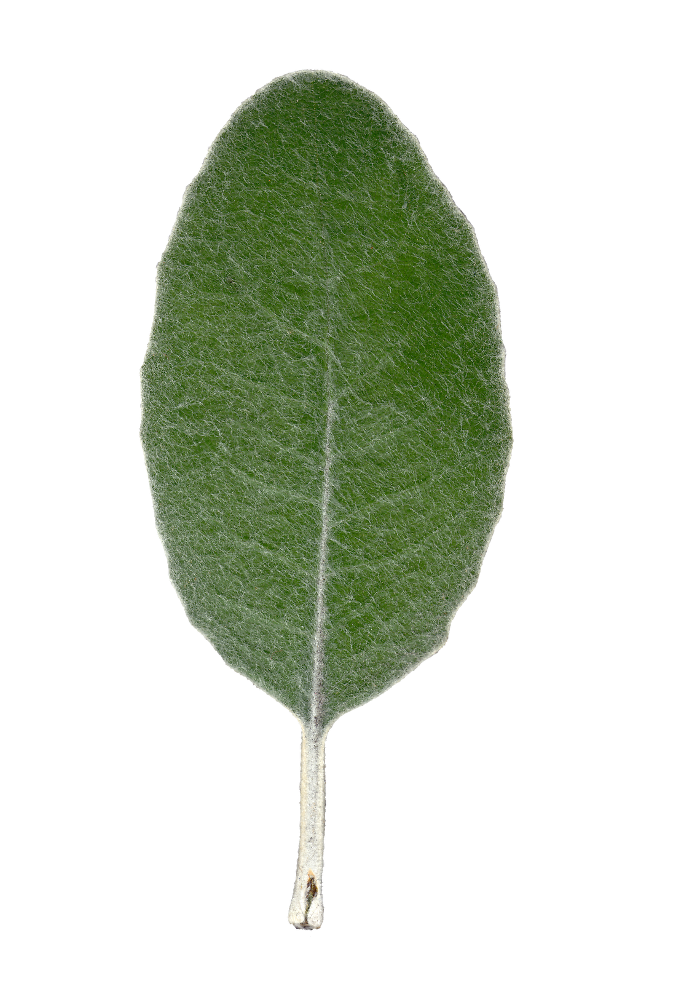
Gated Mixture of Experts

Slide 10
T-SNE
Compares MI Between Gaussians
Reduces to Euclidean Distance
Preserves the Structure

Slide 11
2D T-SNE
High Dimensional

Slide 12
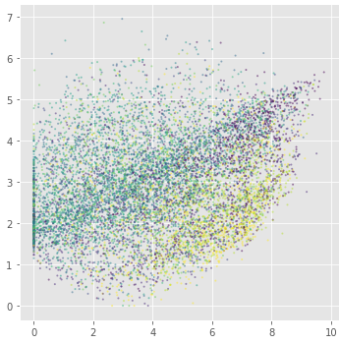
Proposed Model
Pt-SNE

Slide 13
Goal
Model Local Clustering of Neurons
Maintain minimal but existing connections between neighboring clusters
Train Clusters to be Experts but shares knowledge

Slide 14
Contributions
Parametric T-SNE to Create a 2D Feature Map of Feature Space
Gate the MoEs & Promote Regional Specialization with spacial regularization
Sparsely Interconnected MoEs
Sparsely Intra-Connected MoEs

